Slide 1
Chemotaxis Chemical Concentration with CFD
Tim Davison
Advisors:
Dr. Nickels, Dr. Nguyen

Slide 2
Introduction
This project: Uses computational fluid dynamics to model interactions of the chemotaxis performing robot with the environment (Colloidal Lattice Boltzmann)
Model a chemical source with wind by solving advection/diffusion equations
Method computes concentration at each point in the complex environment and feeds to existing controller

Slide 3
Objectives
Understand existing CLB MATLAB code coupled with Rapid Cell
Generate solution for 2D advection/diffusion equation to output concentration with MATLAB PDE Toolbox or other, pre-existing PDE Solver
Implement solution into existing Rapid Cell code using output from LBM
Testing and validation
Document and report results

Slide 4
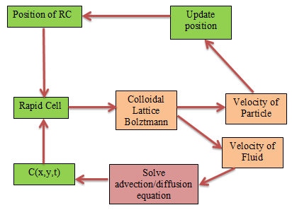

Slide 5



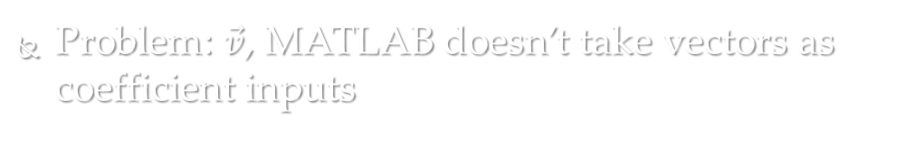
Trying to solve in MATLAB
Advection/diffusion equation
$$\frac{∂C}{∂t}=D\left(\frac{∂^{2}C}{∂x^{2}}+\frac{∂^{2}C}{∂y^{2}}\right)−\left(\vec{v_{x}}\frac{∂C}{∂x}+\vec{v_{y}}\frac{∂C}{∂y}\right)+ f$$
MATLAB’s parabolic PDE form:
-$\left(a\frac{∂C}{∂x}+b\frac{∂C}{∂y}\right)$
$$\frac{∂C}{∂t}−D\left(\frac{∂^{2}C}{∂x^{2}}+\frac{∂^{2}C}{∂y^{2}}\right)+au=f$$
Problem: $\vec{v}$, MATLAB doesn’t take vectors as coefficient inputs

Slide 6
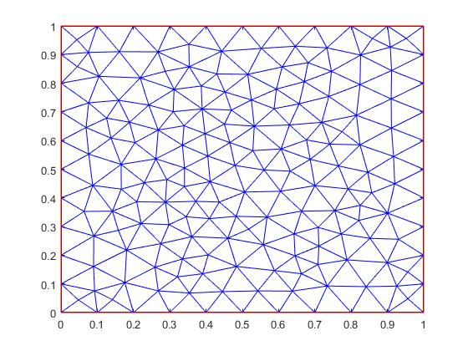
Solving PDE
Get velocity field output from LBM
Compute centroids of triangles used for mesh
Use meshgrid to interpolate velocity field to centroids
Evaluate and create column of f coefficients
Solve PDE!!
Takes forever

Slide 7
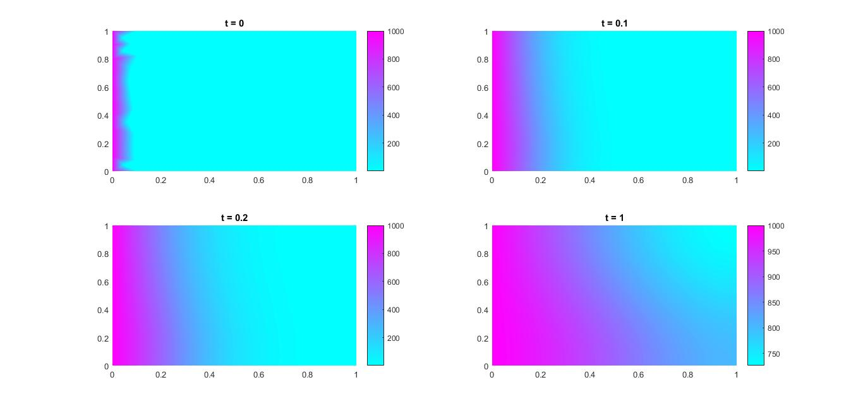
Results

Slide 8
Implementing in rapid cell
Run rapid cell to get initial velocity field
Run PDE solver to get concentration for ten 0.1 second steps
Run rapid cell for one time step to allow robot movement
Run PDE solver for ten steps with new velocity field
Use previous concentration as initial condition

Slide 9
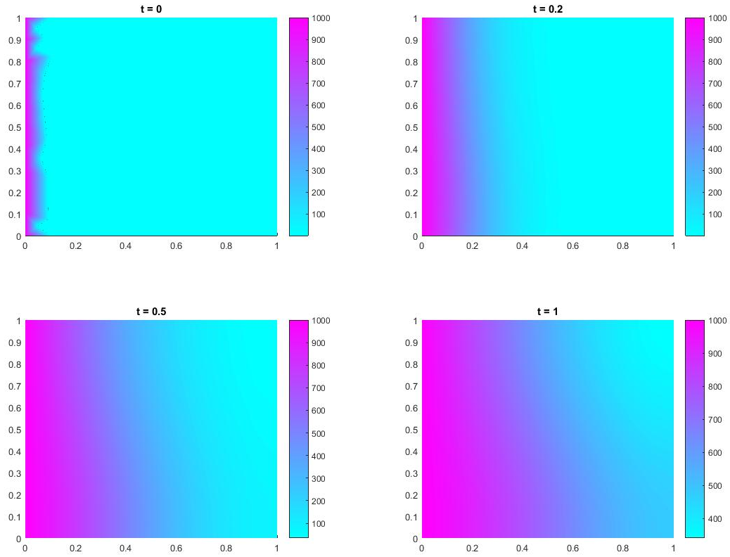
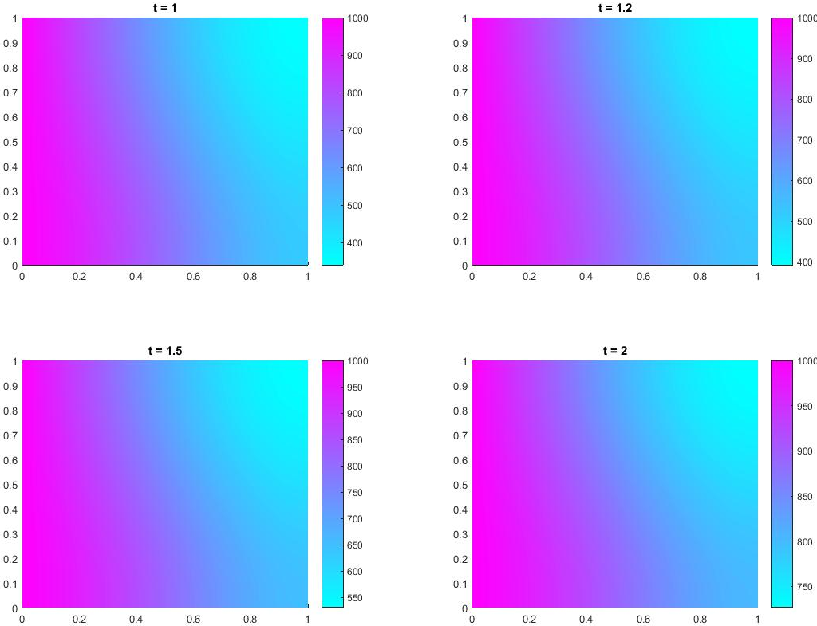
Testing for Rapid Cell

Slide 10
Conclusions
I have a solution to PDE that seems good
Tested for various scenarios
Coupling with rapid cell → going to take a while to run

